Slide 1
Online Chatbot based ticketing system
CSE7301 University Project
FINAL PPT
Batch Number:ISD-07
Roll Number | Student Name
20211ISD0004 | E RAHUL
20211ISD0039 | ABHI C N
20211ISD0019 | V NARENDRA
20211ISD0006 | BODDU KUSHWANTH SAI
Under the Supervision of,
Dr. Jacob Augustine
Professor
School of Computer Science and Engineering
Presidency University
Name of the Program: ISD
Name of the HoD: PALLAVI R
Name of the Program Project Coordinator: Mr. Amarnath J.L & Dr. Jayanthi. K.
Name of the School Project Coordinators: Dr. Sampath A K / Dr. Abdul Khadar A / Mr. Md Ziaur Rahman

Slide 2
Introduction
Managing large volumes of customer interactions efficiently is crucial for organizations offering ticket-based services. To enhance user experience and streamline operations, technology can play a key role through intelligent automation. This project focuses on developing an online chatbot ticketing system designed to handle customer queries, assist with ticket bookings, and provide real-time support. The system integrates natural language processing and database connectivity to interact with users, guide them through the ticket booking process, and generate e-tickets seamlessly. Additionally, it can handle tasks such as payment processing, ticket cancellations, and issuing QR-coded tickets. By automating these functions, the chatbot reduces workload on human operators and ensures timely, accurate responses — leading to improved efficiency and customer satisfaction.

Slide 3
Literature Review
The integration of chatbots into service-based systems has gained significant attention in recent years, driven by advancements in artificial intelligence (AI) and natural language processing (NLP). Chatbots are increasingly being employed in customer service environments to provide instant support, reduce human workload, and enhance user satisfaction.
1. Chatbot Technology and NLP:
Numerous studies have highlighted the growing role of NLP in developing intelligent conversational agents. According to Shawar and Atwell (2007), rule-based and retrieval-based methods laid the foundation for early chatbot development, while recent improvements in machine learning and deep learning have enabled more natural and context-aware interactions. Modern chatbots can now understand user intent and provide context-sensitive replies, thanks to models like BERT and GPT.
2. Applications in Ticketing Systems:
The use of chatbots in ticketing systems has emerged as a viable alternative to traditional interfaces. Research by Jain et al. (2018) demonstrated the effectiveness of chatbot interfaces in railway reservation systems, showing increased speed and accuracy in bookings compared to manual methods. Similarly, integration of chatbots in event ticketing (e.g., concerts, museums) has shown to reduce wait times and improve accessibility.
3. User Experience and Automation:
Studies by Følstad and Brandtzæg (2017) emphasize that user satisfaction in chatbot systems depends on quick response times, clarity in communication, and task completion accuracy. Automated ticketing systems that provide real-time feedback and generate QR codes (used for secure entry) have shown positive results in terms of system usability and acceptance.
4. System Integration and Data Handling:
Integrating chatbots with databases and payment gateways is crucial for a full-featured ticketing system. According to Kumar and Rose (2019), successful chatbot deployment requires backend systems capable of handling user data securely, managing real-time transactions, and updating ticket availability dynamically. These systems often rely on web technologies such as Flask/Django (Python) and SQL-based databases for efficient implementation.
5. Limitations and Future Directions:
Despite their benefits, chatbot-based ticketing systems face challenges such as handling ambiguous queries, managing high traffic during peak times, and providing multilingual support. Current research is focused on incorporating voice-based input, emotion detection, and AI-based recommendation systems to further personalize user experience.

Slide 4
RESEARCH GAPS IDENTIFIED
Limited Domain-Specific Chatbots: While many general-purpose chatbots exist, there is a lack of domain-specific ticketing bots tailored to niche areas like museums, local transport, or small-scale events. Most existing systems are developed for large-scale platforms (e.g., airlines, movie ticketing), leaving smaller service providers with inadequate solutions.
Context Retention and Multi-turn Dialogue: Many chatbot systems struggle with maintaining context over multiple user interactions. This leads to poor handling of follow-up questions, ticket modifications, or cancellations. More research is needed on context-aware NLP models for smoother multi-turn conversations.
Real-Time Integration with Dynamic Databases: Some chatbots lack real-time synchronization with databases, resulting in outdated ticket availability or booking errors. There's a need for more research on seamless, low-latency database integration with chatbot interfaces.
Security and Data Privacy: Many existing systems don’t fully address user privacy and payment data protection. As chatbots increasingly handle sensitive information, robust mechanisms for secure transactions and data encryption are essential but under-researched.
Emotion and Sentiment Recognition: Most current ticketing chatbots are task-oriented and do not consider the emotional tone of the user, which can impact user satisfaction during stressful situations like cancellations or technical issues. Research into emotion-aware chatbots in the ticketing domain is still in its early stages.
Accessibility for Users with Disabilities: Few systems consider inclusivity features such as voice input for visually impaired users or easy navigation for users with motor disabilities. There is a clear gap in creating universally accessible chatbot interfaces.
Scalability and Load Handling: During peak hours or high-demand events, chatbot systems may lag or crash. Research is needed into scalable architectures and load-balancing strategies to ensure consistent performance under heavy traffic.

Slide 5
Proposed Methodology
The proposed methodology for the online chatbot ticketing system involves designing an intelligent, user-friendly interface that automates the ticket booking process through natural language interaction. Initially, the system requirements are analyzed to determine key functionalities such as ticket booking, cancellation, payment processing, and answering frequently asked questions. Based on this, a modular system architecture is developed, comprising a chatbot frontend, a Natural Language Processing (NLP) engine, a backend database, a payment gateway, and a QR code generation module.
The chatbot is developed using NLP frameworks such as Dialogflow, Rasa, or custom-built Python libraries like NLTK or spaCy. It is trained to understand user intents such as booking tickets, inquiring about availability, and canceling reservations. The chatbot interface is designed to guide the user step-by-step through the booking process. Once user details and ticket preferences are collected, the chatbot interacts with a real-time database to check availability and confirm bookings.
Upon confirmation, the system processes payments through a secure gateway and generates an electronic ticket embedded with a unique QR code for verification and entry. All user data, booking details, and transaction records are stored securely in the database. The system also provides users with real-time updates and support, enhancing overall user experience and operational efficiency. This methodology ensures a streamlined, accessible, and automated ticketing system powered by conversational AI.

Slide 6
Objectives
Automate the Ticket Booking Process: Develop a chatbot system capable of handling ticket bookings, cancellations, and modifications without human intervention.
Enhance User Experience: Provide an intuitive, conversational interface that allows users to interact naturally and easily using simple language.
Integrate with Real-Time Databases: Ensure the chatbot can access and update ticket availability in real-time to prevent overbooking and ensure accurate information.
Enable Secure Payment Processing: Incorporate a secure payment gateway to handle transactions safely and efficiently during the booking process.
Generate QR Code-Based E-Tickets: Automatically generate digital tickets with unique QR codes for verification and access control.
Provide 24/7 Availability and Support: Ensure the chatbot is available around the clock to assist users with queries and transactions at any time.
Ensure Scalability and Performance: Design the system to handle a large number of simultaneous users, especially during peak times or special events.
Improve Operational Efficiency: Reduce the workload on human staff by automating repetitive tasks, thus enabling faster response and lower operational costs.
Ensure Data Privacy and Security: Safeguard user information and transaction details through secure data storage and encryption techniques.
Support Future Enhancements: Build the system with flexibility for future upgrades such as multilingual support, voice-based input, or integration with mobile apps.

Slide 7
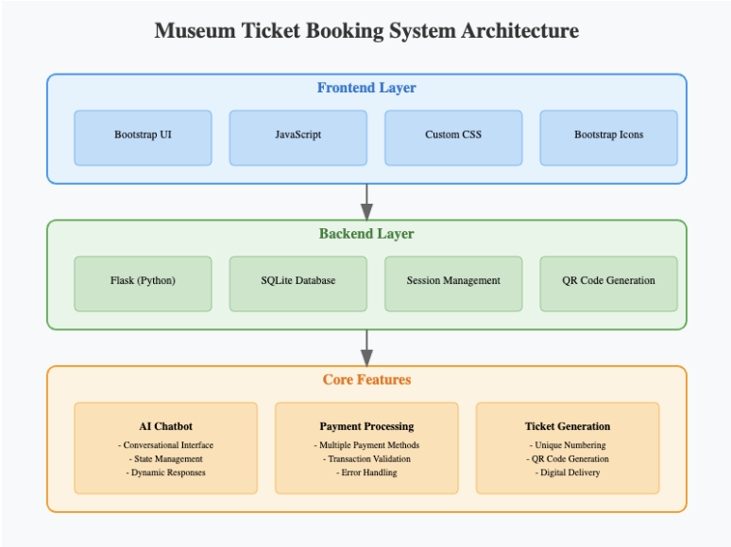
System design – Architecture diagram

Slide 8
Implementation steps
Implementation Steps
1. Requirement Gathering and Analysis
Identify the purpose, target users, and scope of the chatbot ticketing system.
List essential features such as booking, cancellation, payment, and ticket generation.
Choose the platform (e.g., web app, mobile app) and chatbot framework (e.g., Dialogflow, Rasa, custom Python bot).
2. System Design
Design the overall system architecture including:
Chatbot interface.
Backend server.
Database (e.g., MySQL, PostgreSQL).
QR code generator.
Payment gateway.
Create flowcharts or conversation trees to define chatbot dialogue paths.
3. Chatbot Development
Build the chatbot using NLP tools (Dialogflow, Rasa, or Python with NLTK/spaCy).
Train it to recognize intents like:
"Book a ticket"
"Cancel a ticket"
"Show available slots"
"Help / FAQs"
Implement fallback responses for unrecognized queries.
4. Backend Development
Set up a backend using Flask, Django, or Node.js to handle:
User data management.
Ticket status updates.
Integration with the chatbot and database.

Slide 9
5. Database Setup
Design and create relational tables to store:
User details.
Event/session/ticket availability.
Booking history and payment logs.
6. Payment Gateway Integration
Integrate a secure payment system (e.g., Razorpay, Stripe, PayPal).
Handle payment confirmation and booking validation.
7. QR Code Generation
Generate a unique QR code for each confirmed booking.
Attach the code to the digital ticket (PDF or email format).
8. Testing and Debugging
Perform unit testing for chatbot functions and backend APIs.
Test the end-to-end workflow (query → booking → payment → ticket).
Fix bugs and improve accuracy of chatbot responses.
9. Deployment
Deploy the application on a web server or cloud platform (e.g., Heroku, AWS, Render).
Ensure SSL certification, mobile responsiveness, and server uptime.

Slide 10
Hardware and Software Details
Hardware and Software Requirements
To develop and deploy the online chatbot ticketing system, certain hardware and software components are essential.
Hardware Requirements: A system with at least an Intel i5 or AMD Ryzen 5 processor is recommended to handle development tasks efficiently. The system should have a minimum of 8 GB of RAM, although 16 GB is preferable for smoother multitasking, especially when using resource-intensive development tools. A storage capacity of at least 250 GB is required, with SSD storage preferred for faster performance. A display of 13 inches or more is suitable for development work. Additionally, a stable internet connection is necessary for downloading dependencies, accessing APIs, and deployment. Basic peripherals such as a keyboard, mouse, and optionally a webcam (for testing future voice or video interaction features) are also needed.
Software Requirements: The project can be developed on any major operating system, including Windows 10/11, Ubuntu 20.04 or later, or macOS. The primary programming language used will be Python, along with JavaScript for any frontend enhancements. Frontend development can be carried out using HTML5, CSS3, and optionally frameworks like React or Bootstrap for better UI/UX. The backend will be developed using Python frameworks such as Flask or Django, or alternatively Node.js. For data storage and retrieval, databases like MySQL, PostgreSQL, or SQLite will be used.
For the chatbot functionality, tools like Dialogflow or Rasa can be used. Alternatively, Python-based NLP libraries such as NLTK and spaCy may be employed for building a custom chatbot. The system will also use libraries like qrcode or pyqrcode for QR code generation. Secure online payments will be facilitated through APIs provided by gateways like Razorpay, Stripe, or PayPal.
Version control will be managed using Git with repositories hosted on platforms like GitHub or GitLab. Development and code editing can be done in IDEs such as Visual Studio Code, PyCharm, or Jupyter Notebook. For deployment, platforms like Heroku, AWS EC2, Render, or Firebase Hosting can be used to host the chatbot and backend services.

Slide 11
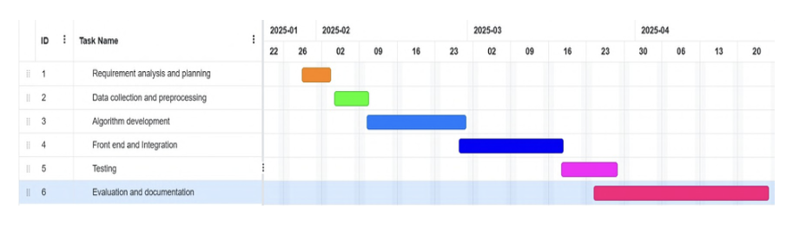
Timeline of project - GHANT CHART

Slide 12
Expected Outcomes
Automated Ticket Booking Interface: A fully functional chatbot that can guide users through the ticket booking process using natural language, eliminating the need for manual handling.
User-Friendly Conversational Experience: The system will provide a smooth, intuitive, and interactive user experience, allowing users to communicate with the chatbot as they would with a human assistant.
Real-Time Ticket Management: Real-time integration with the backend database will allow users to view available tickets, book or cancel reservations, and receive immediate updates.
Secure Payment and Verification System: Integration with a secure payment gateway will enable safe online transactions. Upon successful booking, the system will generate a unique QR code for verification and entry.
24/7 Availability: The chatbot will operate continuously without downtime, ensuring users can access ticketing services at any time of day.
Efficient Resource Management: By automating repetitive tasks and reducing human involvement, the system will contribute to faster response times, lower operational costs, and reduced workload for staff.
Data Handling and Record Maintenance: The system will maintain a structured database of user information, booking records, and transaction history for easy access, audits, and future analysis.
Scalability and Upgrade Potential: The modular design will allow the system to be extended in the future with features such as multilingual support, voice input, personalized recommendations, or integration with mobile applications.
Improved Customer Satisfaction: The fast, accurate, and responsive nature of the chatbot will enhance the overall user experience, leading to increased satisfaction and trust in the service.

Slide 13
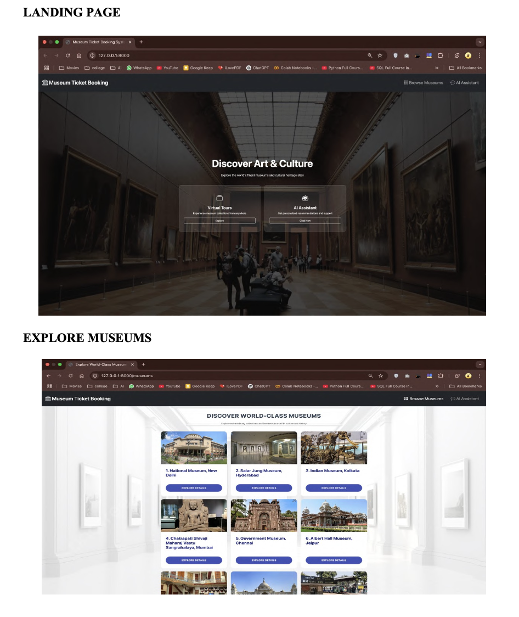
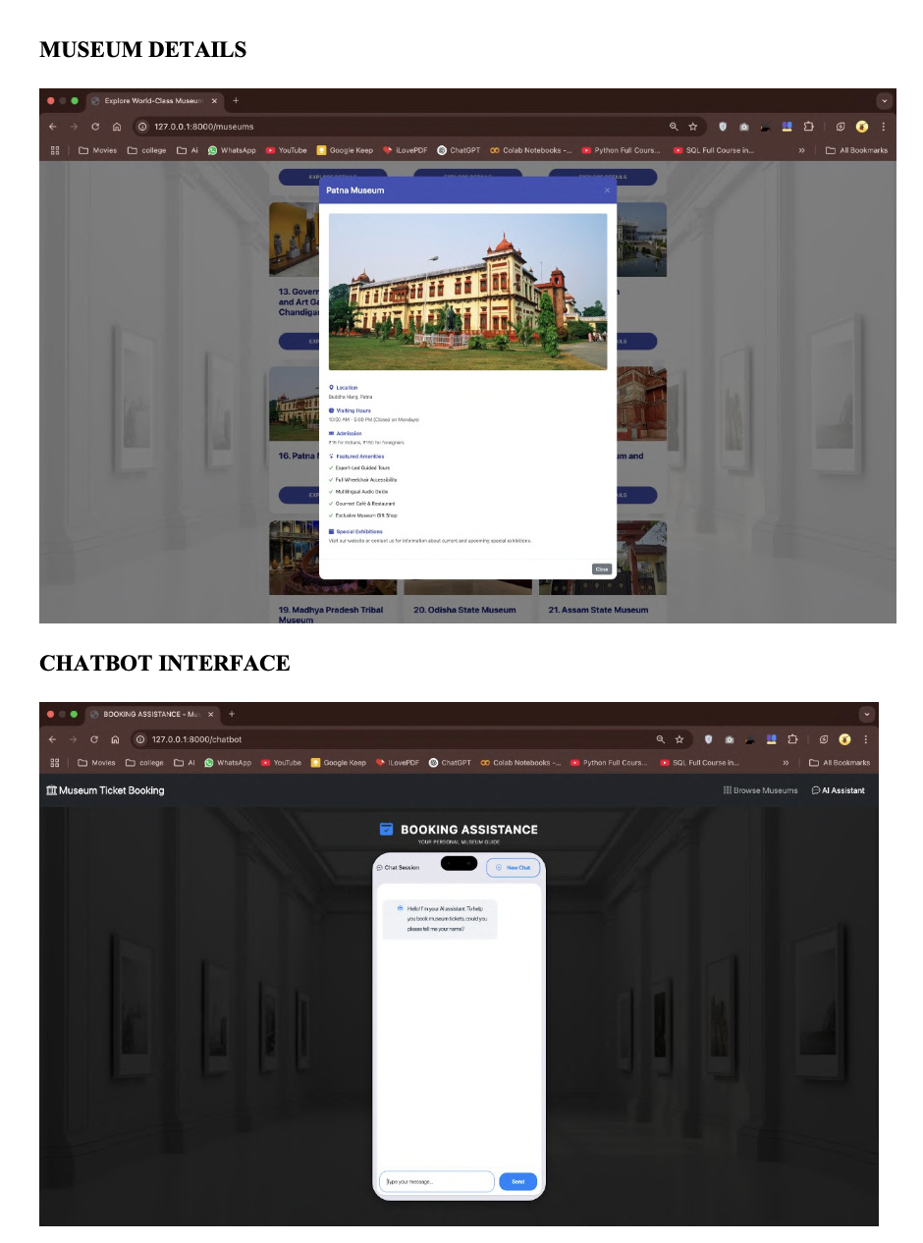
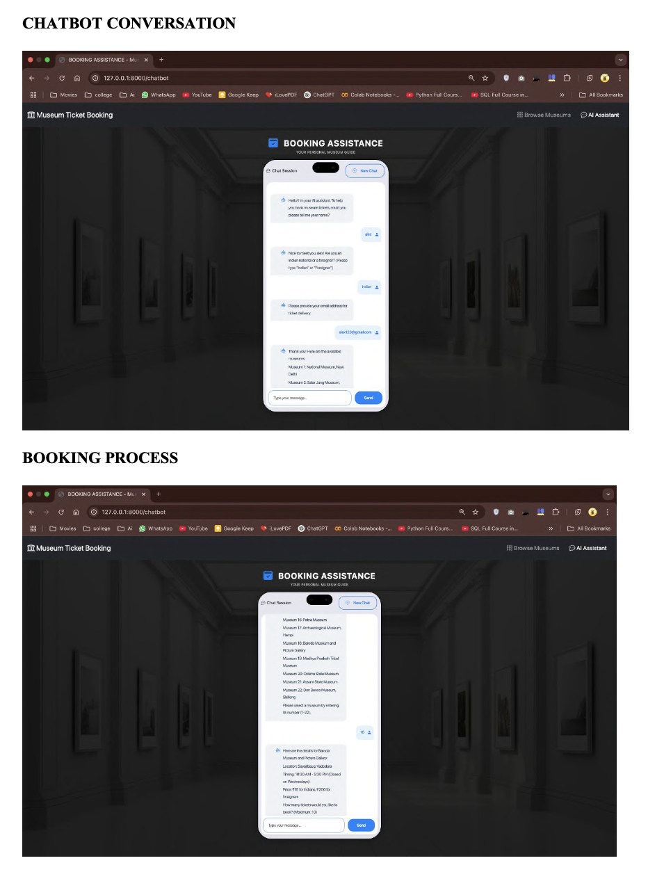
Results

Slide 14
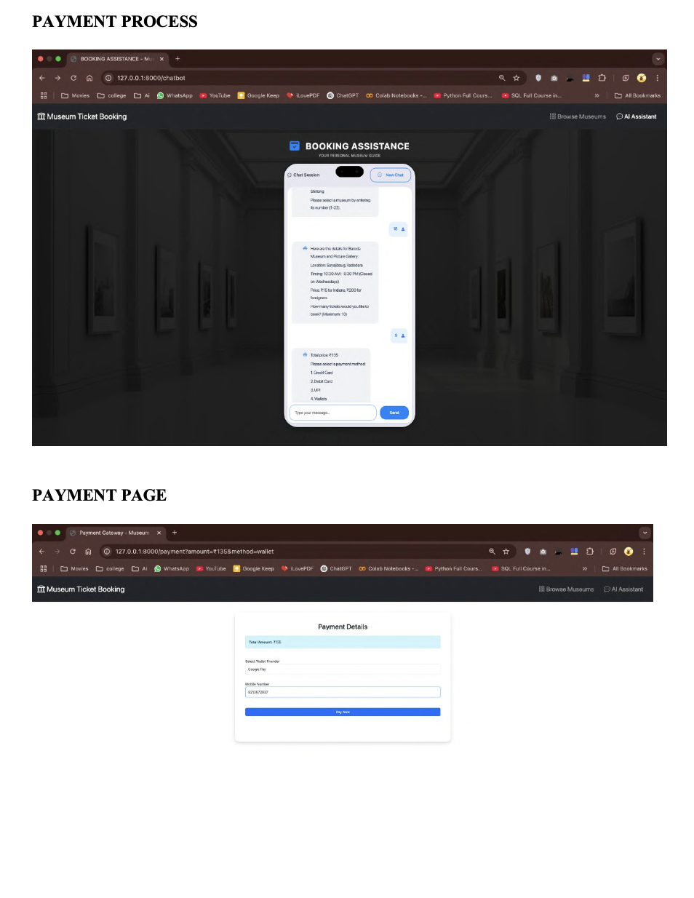
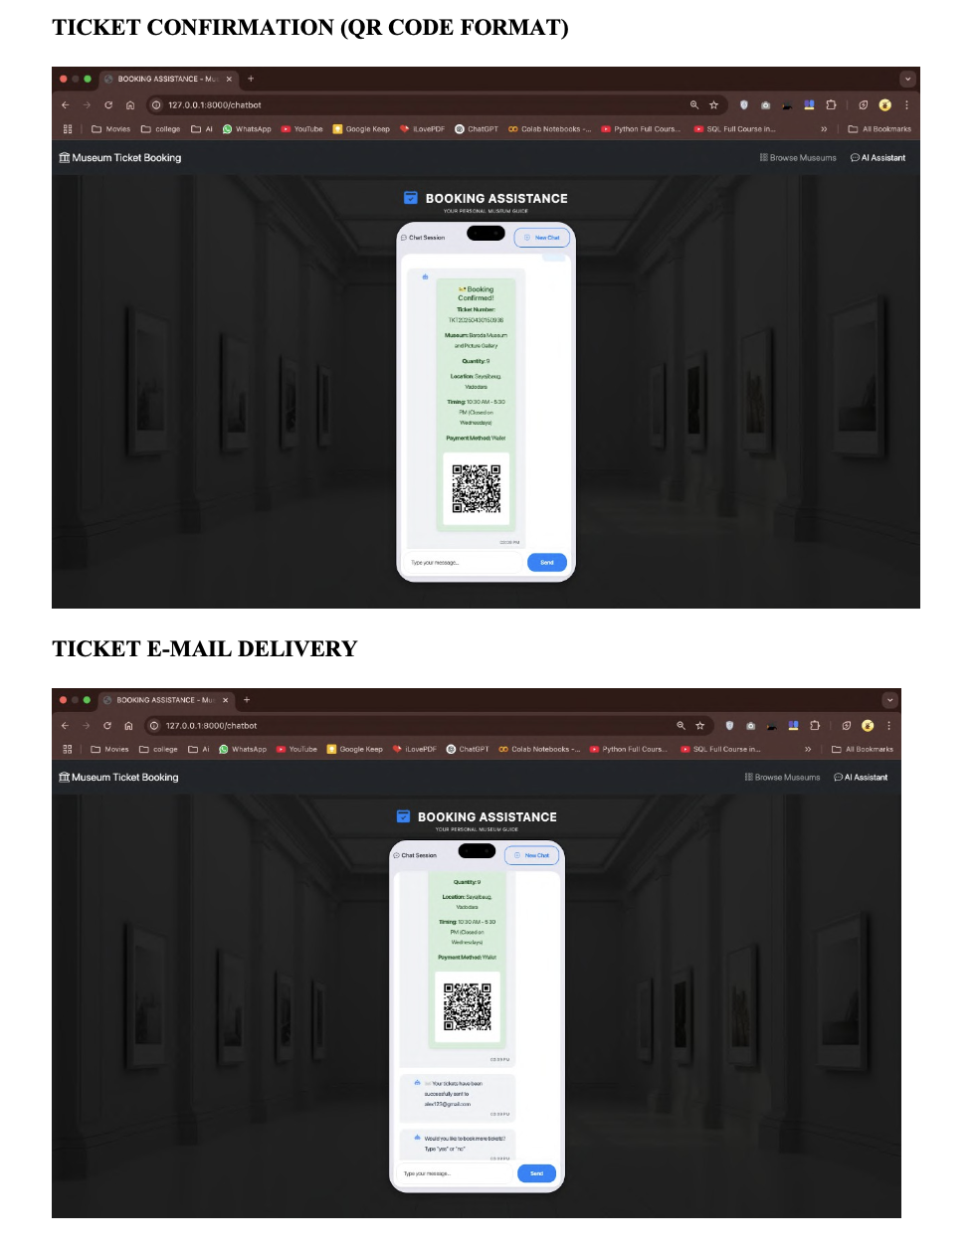

Slide 15
Conclusion
The online chatbot ticketing system offers an efficient and user-friendly solution to automate the ticket booking process, enhancing both customer experience and operational efficiency. By leveraging natural language processing and real-time database integration, the system provides seamless interaction, quick responses, and accurate ticket management. Secure payment integration and QR code-based ticketing further add to its reliability and convenience. The chatbot’s 24/7 availability ensures continuous service, reducing dependence on human agents and minimizing delays. Overall, this project demonstrates how conversational AI can transform traditional ticketing services into an accessible, scalable, and cost-effective platform, paving the way for future enhancements and wider adoption.

Slide 16
References
Kumari, P., Kumari, S., Jaiswal, S., Chaturvedi, S., Jha, S. K., and Chaturvedi, P. (2024)
‘AI-based chatbot for online ticketing systems’, Journal of Intelligent Systems.
Sanjana, P. (2025) ‘Enhancing user experience through chatbot-based ticketing systems’,
International Conference on Artificial Intelligence and Human Interaction.
Byrne, B., Krishnamoorthi, K., Ganesh, S., and Kale, M. S. (2020) ‘TicketTalk: A data-
driven approach to transaction-based dialog systems’, Proceedings of the 58th Annual Meeting
of the Association for Computational Linguistics.
Mary, P. A., Aishwarya, S., and Gowthami, K. (2025) ‘Intelligent online chatbot system for
railway ticketing’, Journal of Transportation and Technology.
Vinodhkumar, S., Kumar, P., Monisha, R., and Khorakiwala, M. A. (2024) ‘A chatbot-
based ticket booking system for multi-modal transportation’, International Journal of
Automation and Computing.
Anonymous (2024) ‘Application of chatbots and virtual assistants in ticket booking systems’,
AI and Business Review.
Anonymous (2024) ‘Chatbot integration in ticketing systems: Transforming Museum ticket
purchasing’, Journal of AI and Cultural Management.
Anonymous (2018) ‘Ticketing chatbot service using serverless NLP technology’, Conference
on Cloud Computing and AI Solutions.
Shahane, S. (2024) ‘Implementing a chatbot-based ticketing system using Dialogflow and
Llama LLM’, International Journal of Computer Science Research.

Slide 17
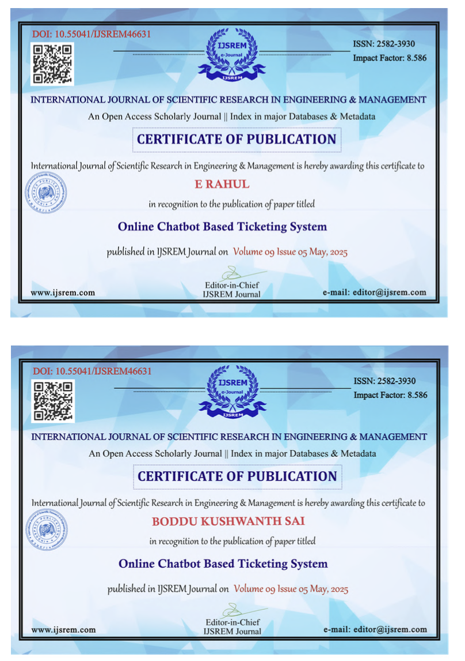
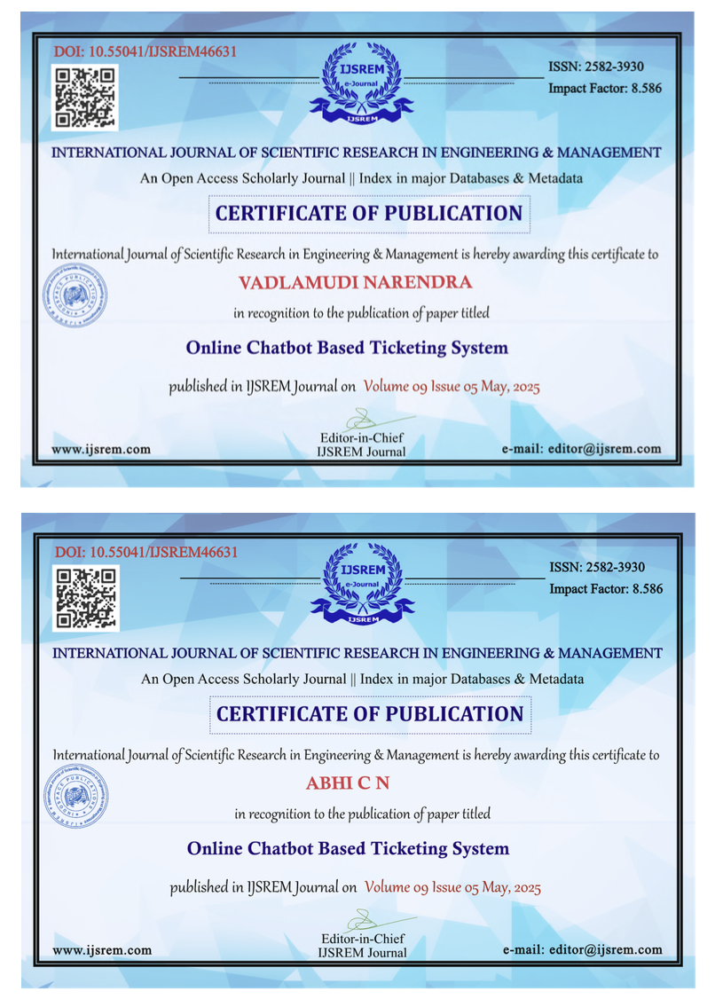
Publication

Slide 18


